Slide 1
Extracting Breast Cancer Phenotypes from Clinical Notes: Comparing LLMs with Classical Ontology Methods
Abdullah Bin Faiz, Arbaz Khan Shehzad, Asad Afzal, Momin Tariq, Muhammad Siddiqi, Muddassar Farooq
22nd International Conference of Artificial Intelligence in Medicine (AIME), 2024
Salt Lake City, Utah, United States
7/4/2024

Slide 2
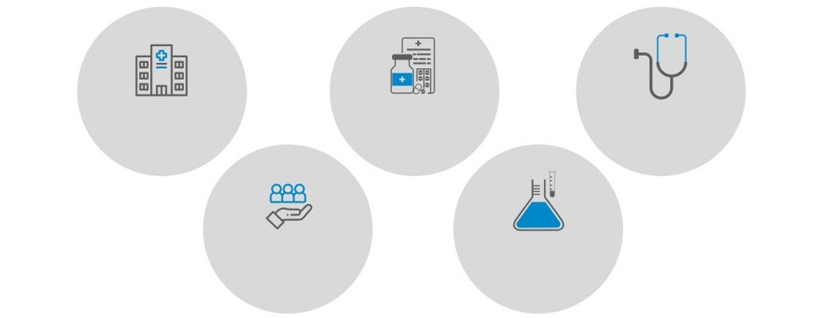
CureMD
A global, integrated healthcare products & services company
3500+
locations
32
specialties
12000+
Providers
24 million
patients
2000+
integrations
7/4/2024

Slide 3


MedicalMind
Patient Query
Fetch Data
Data Lakehouse
Extraction and Curation of Features
Inference Engine Training and Explanation
Knowledge Engineering
Interface
Data
Lake
Feature Engineering
Inference Engine
Explainable Model
7/4/2024

Slide 4
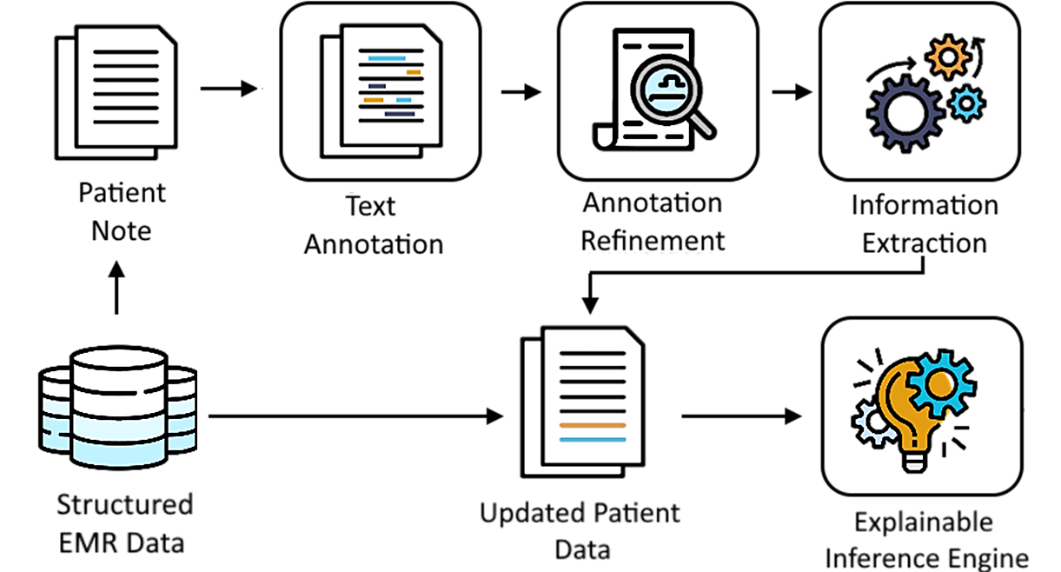
Smart Annotator Workflow
7/4/2024

Slide 5
Motivation
Limitations of the ontology system:
Omission
Failure to pick out semantic relationship within notes
Selectivity
The system does not generalize to other phenotypes and diseases
Processing Time
Linearly dependent on the length of note, it can take up to a minute to process a note
Dependency
System uses the NCBO NCIt API for entity annotation
7/4/2024
5

Slide 6




Impact of Limitations
Inaccurate AI Models
Limited Scalability
Exponential growth in processing time
Vulnerability to Failure
7/4/2024
6

Slide 7
Suggested Approach
Use a Large Language Model
The LLM (Llama 3-8B) will process the note and generate phenotypes in a structured response
Handle semantic relationships and dependency issues
Implement a Retriever
The Retrieval Augmented Generator picks out only the information in the note requested to be processed
Intuition is to process less tokens and reduce hallucinations
7/4/2024
7

Slide 8
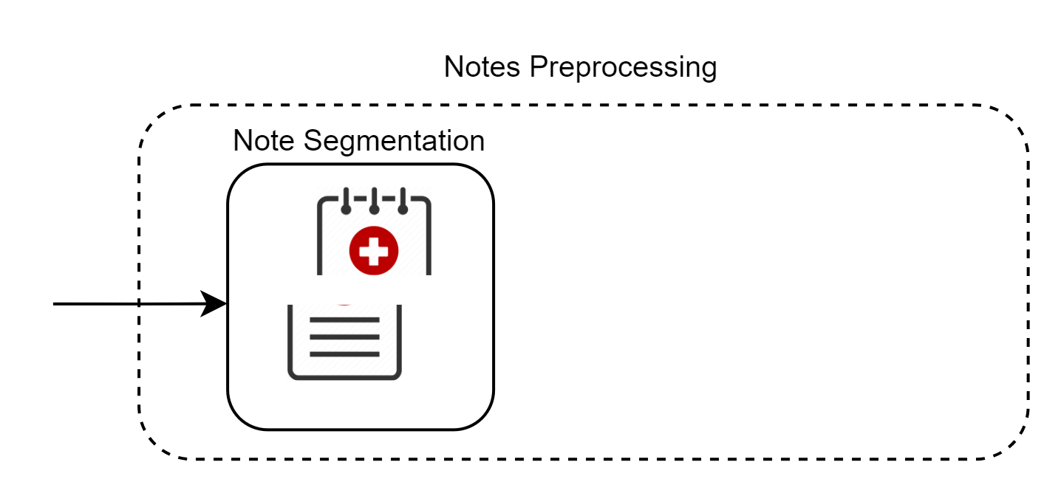
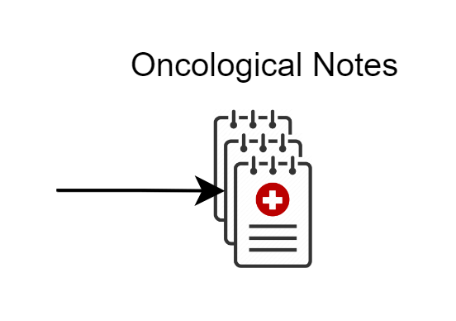
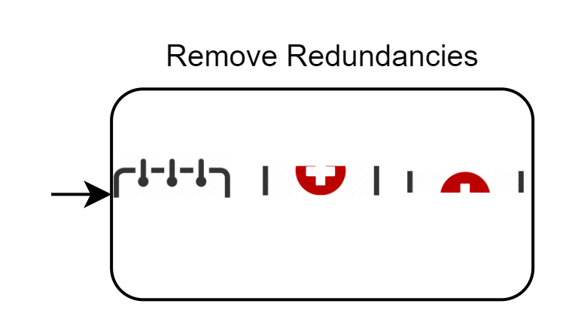
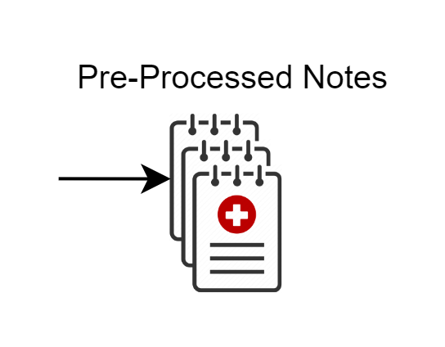
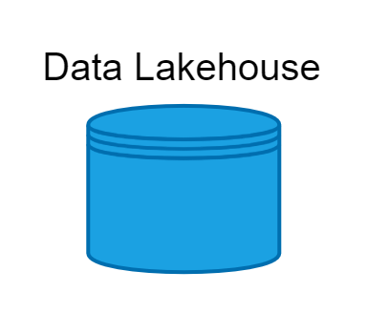
Preprocessing Pipeline
7/4/2024
8

Slide 9
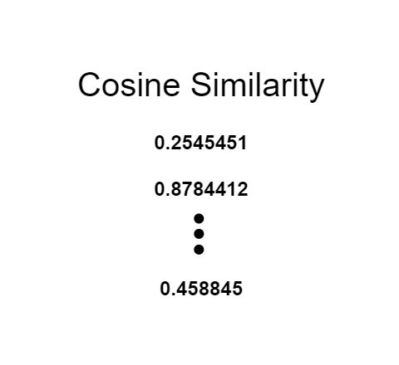
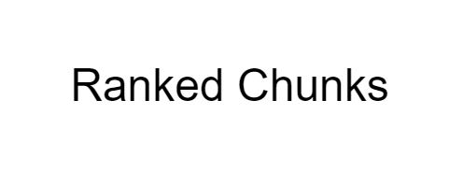
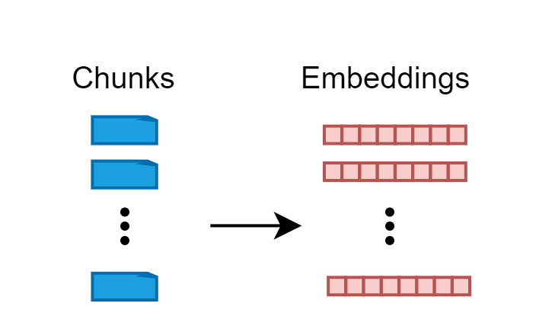
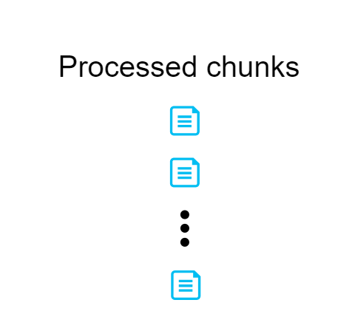
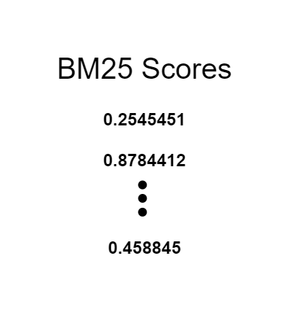
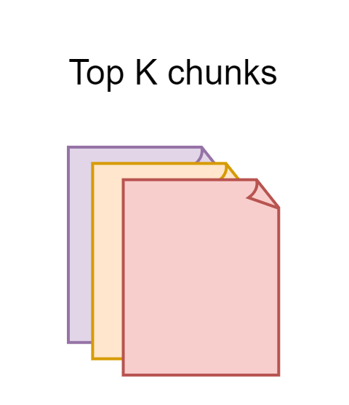
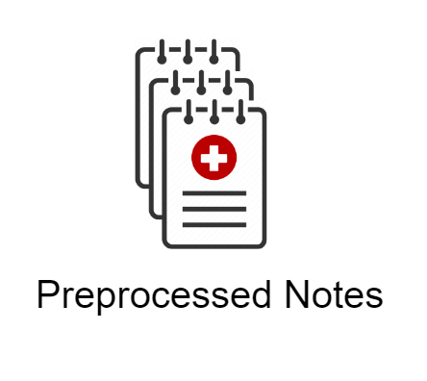
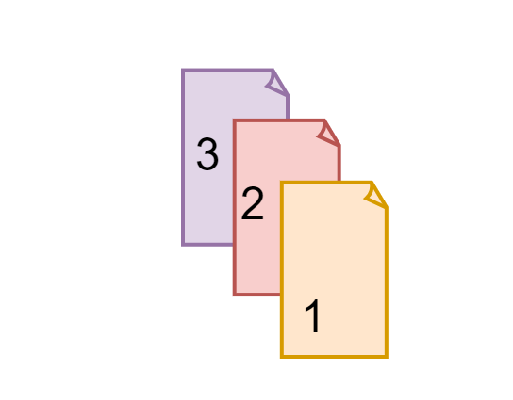
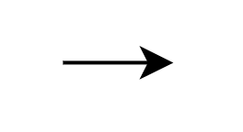
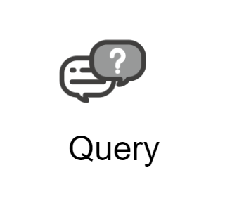
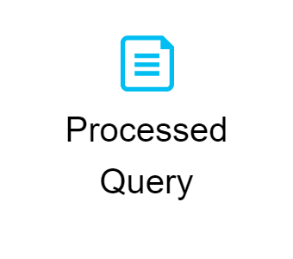
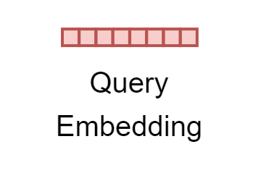
Semantic Ranking
Lexical Ranking
7/4/2024
9

Slide 10

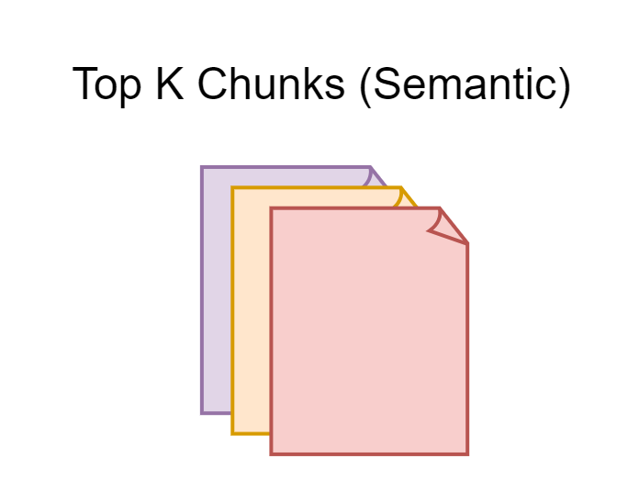

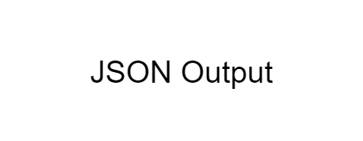
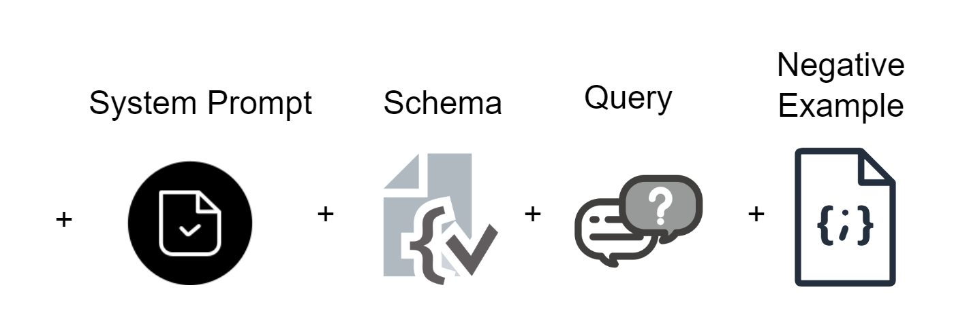

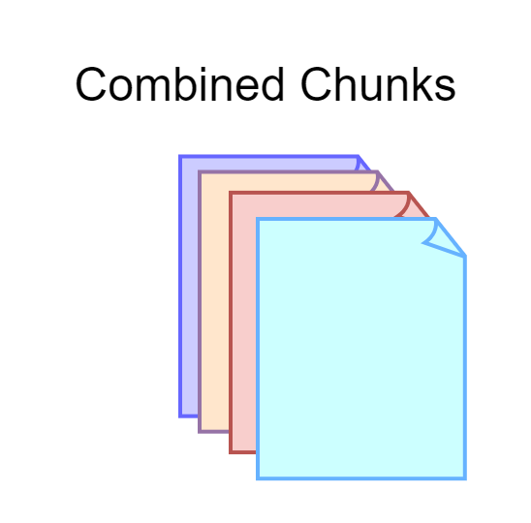

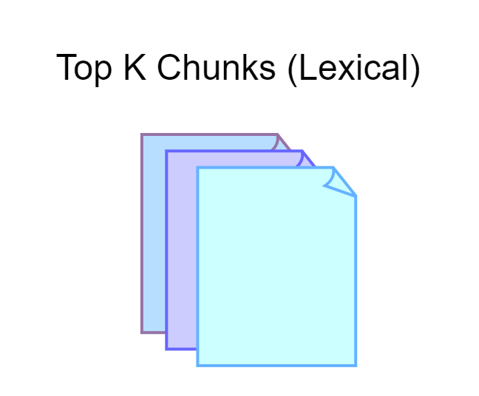
LLM Inference

Slide 11

Clinical Validation
Precision
The portion of labels that were hallucinations by the system
Manual Validation of 150 notes by 5 Physicians for ground truth labels compared with LLM responses
Recall
The portion of labels that were skipped by the system

Slide 12
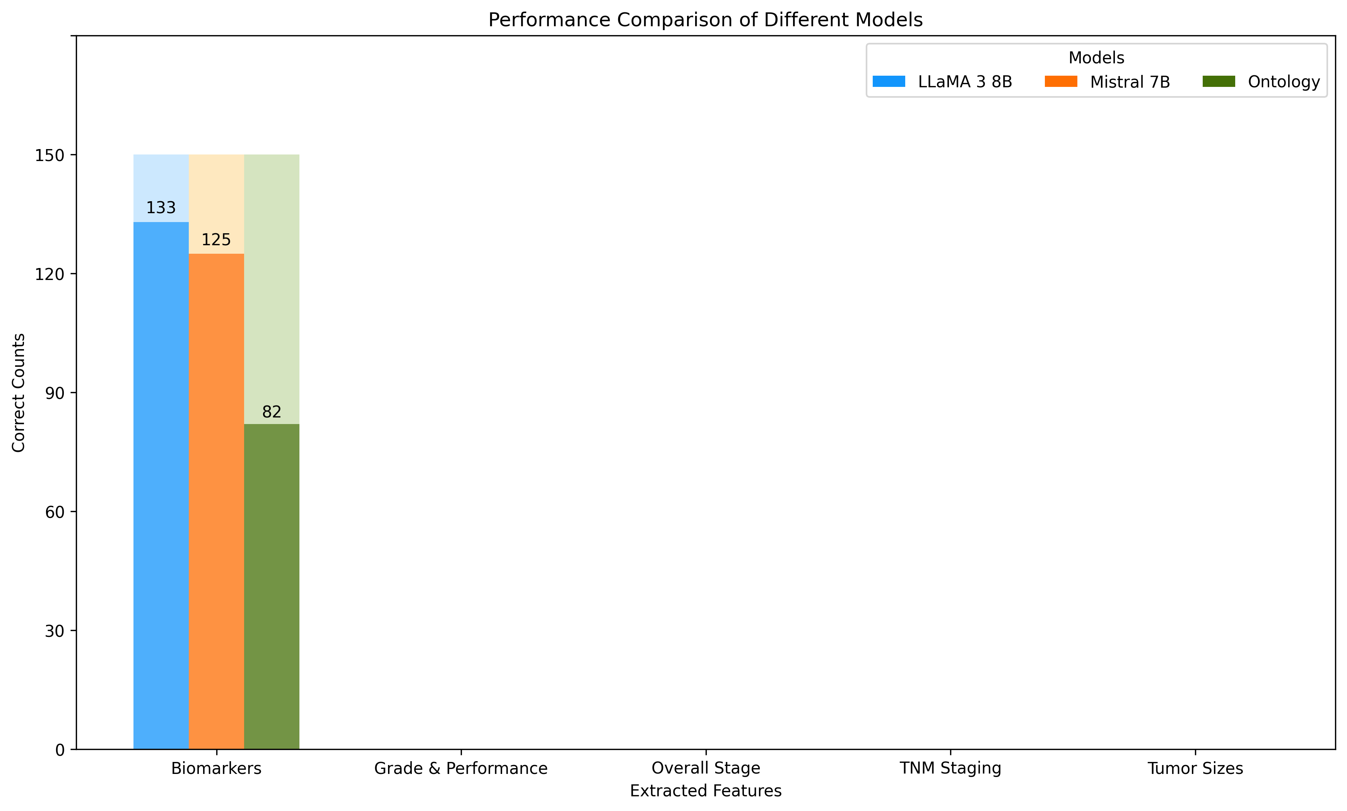
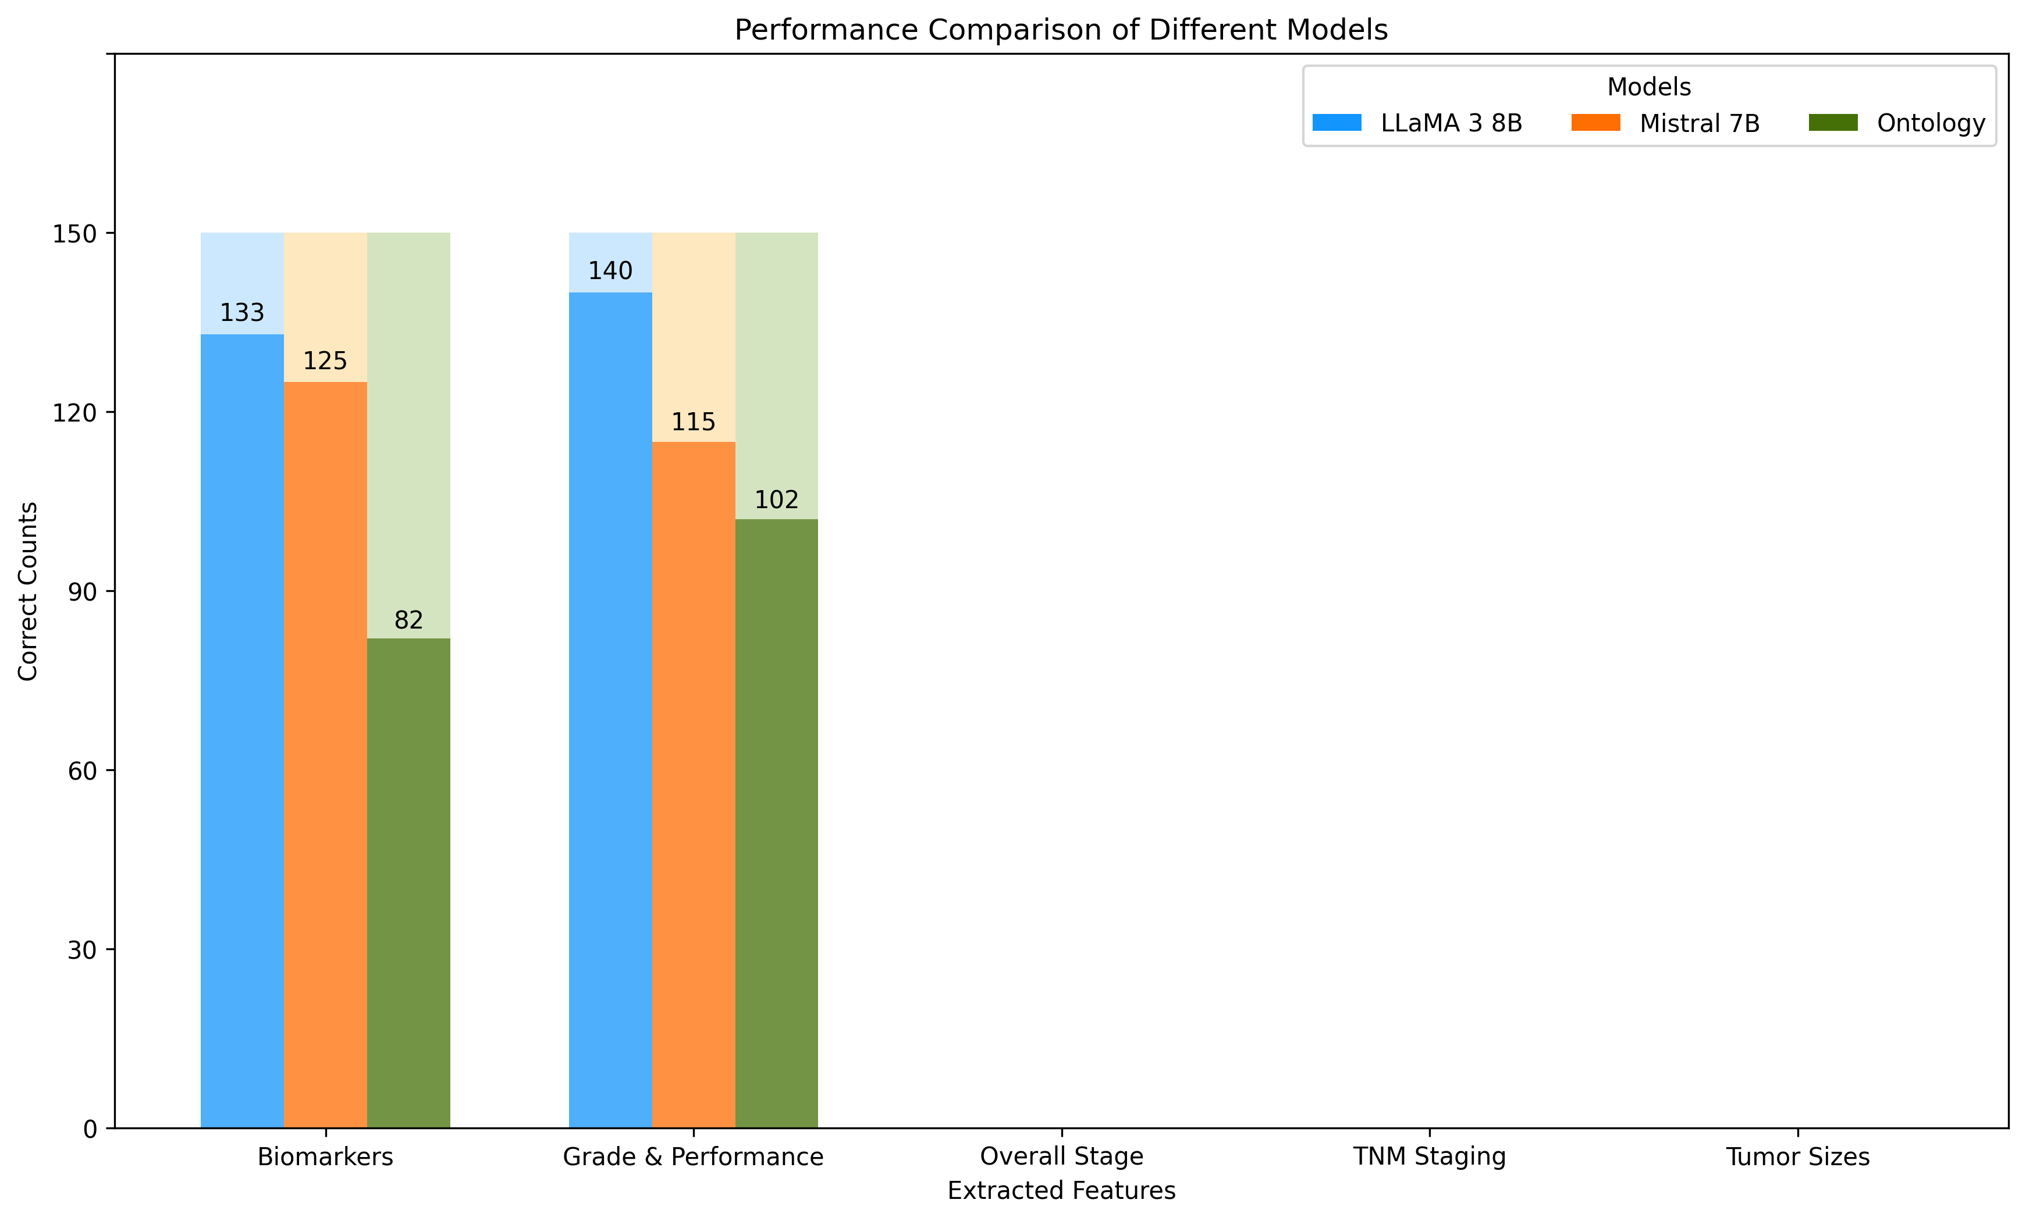
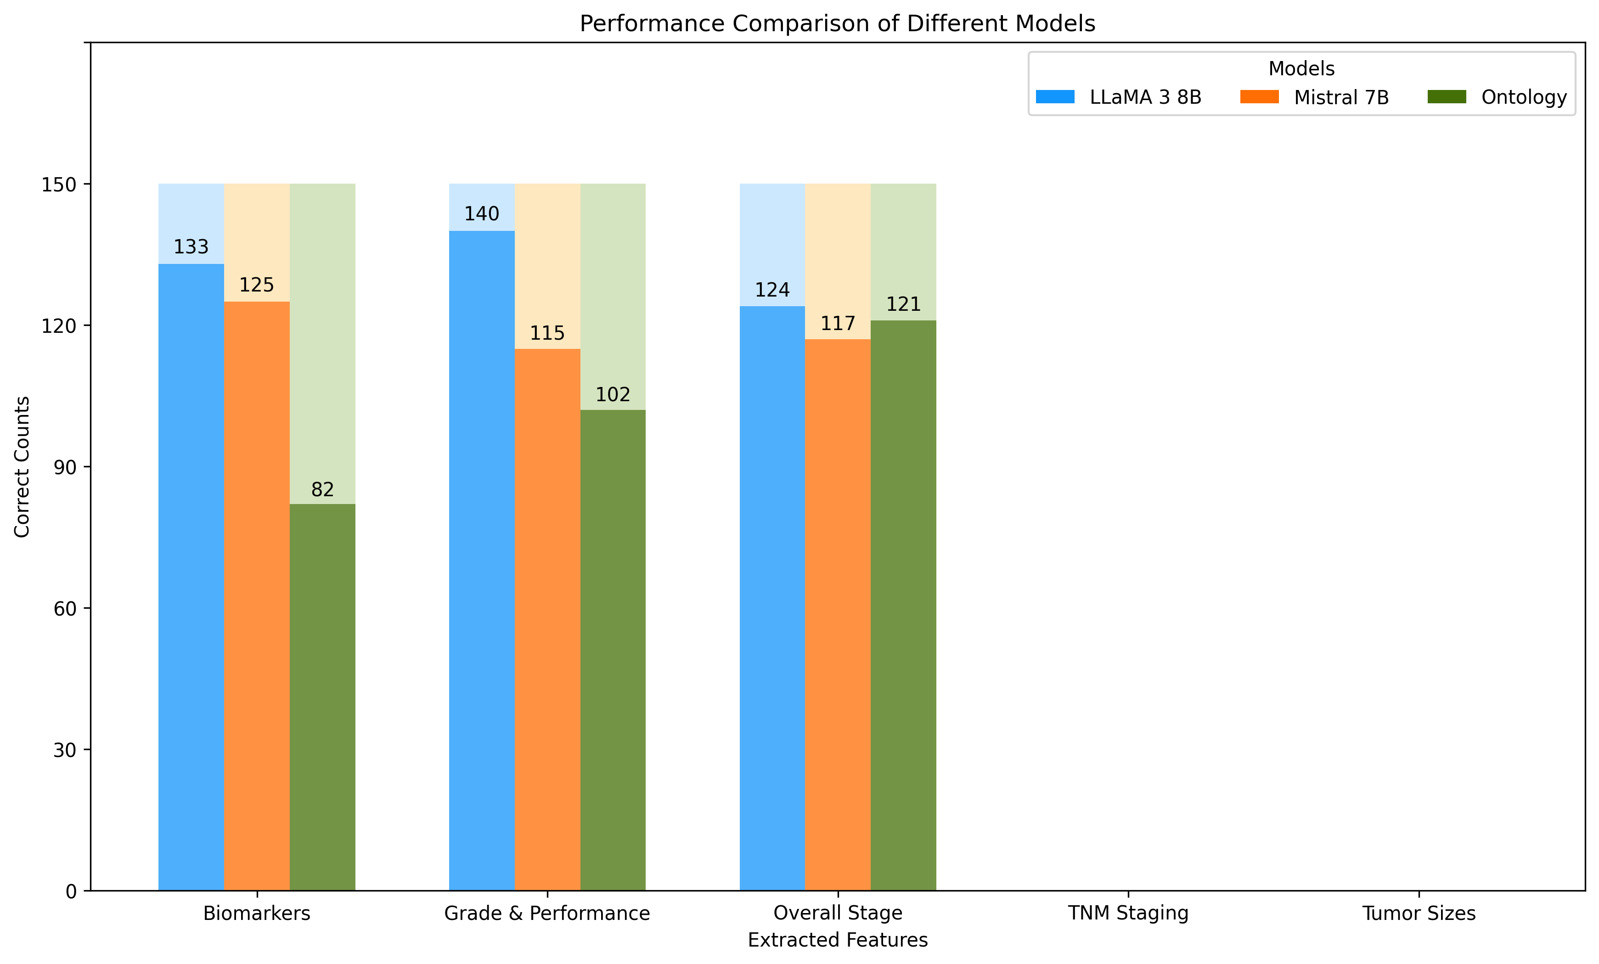
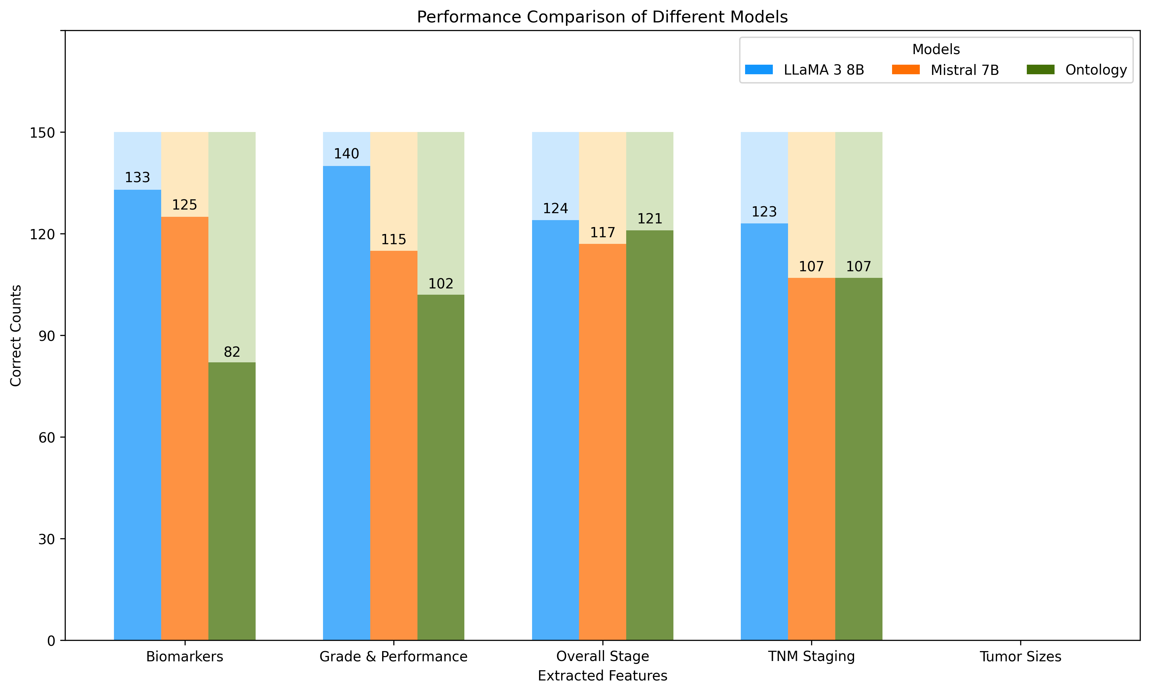
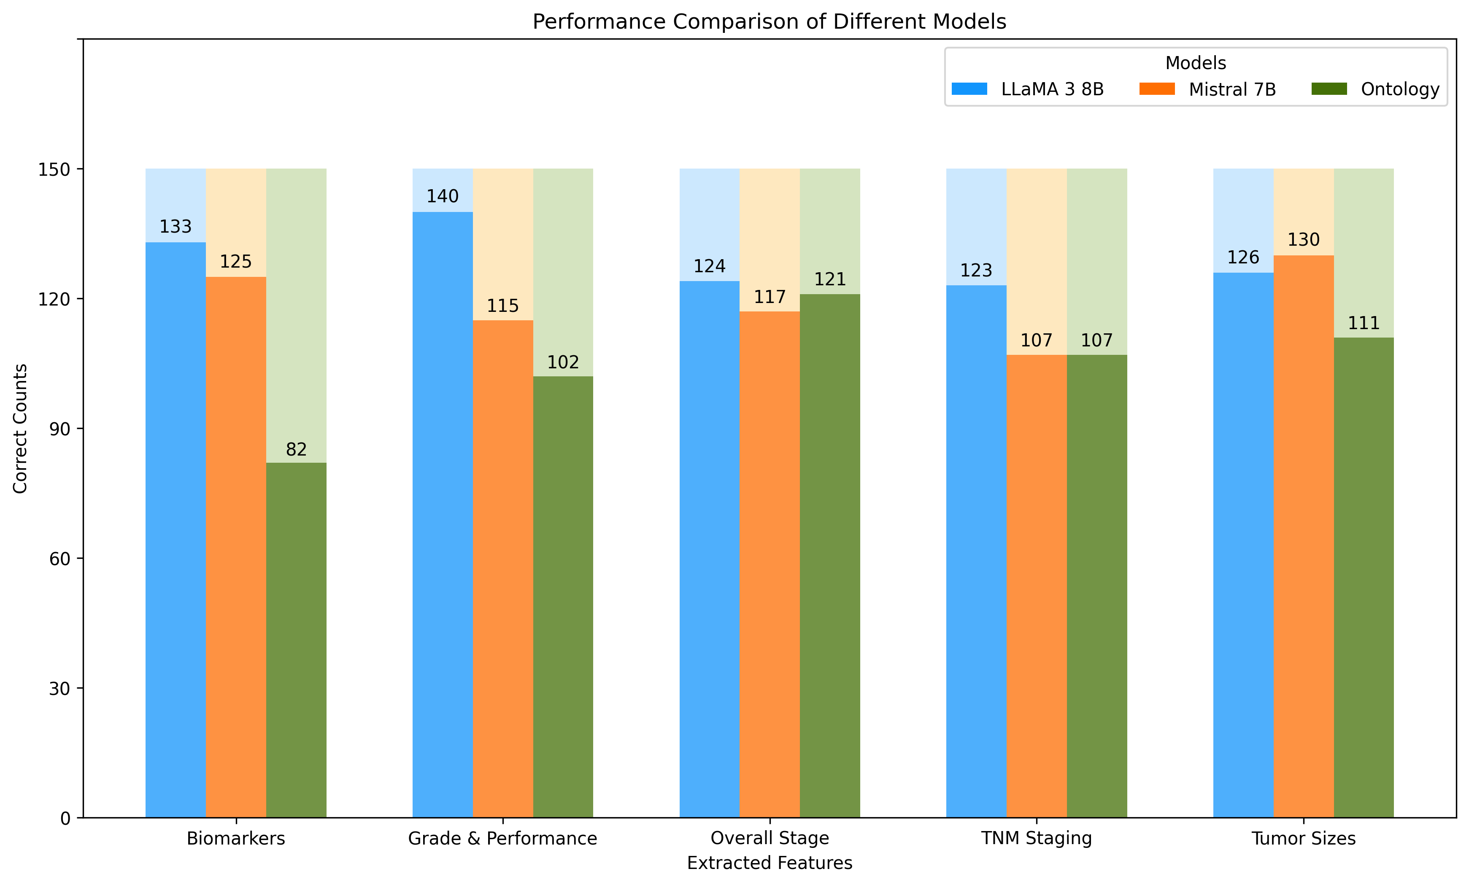
Results
Biomarkers
Estrogen/Progesterone Receptors, HER-2
Performance
ECOG, KARNOFSKY
7/4/2024

Slide 13
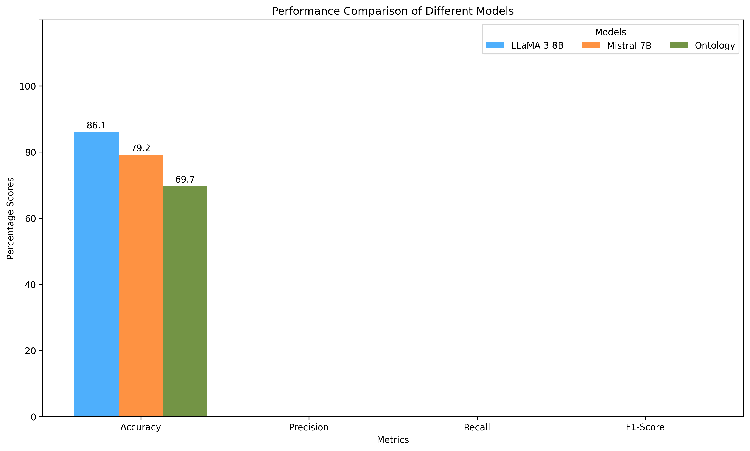
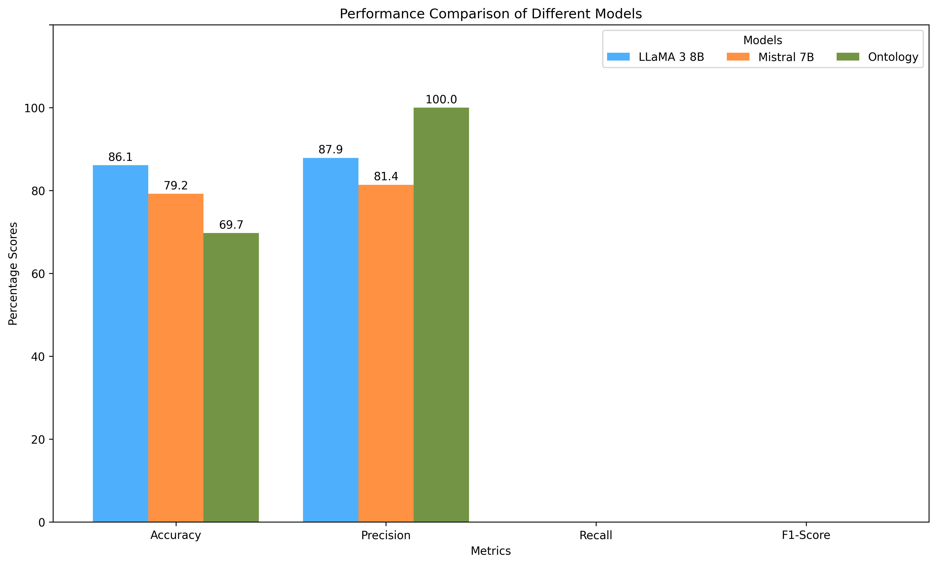
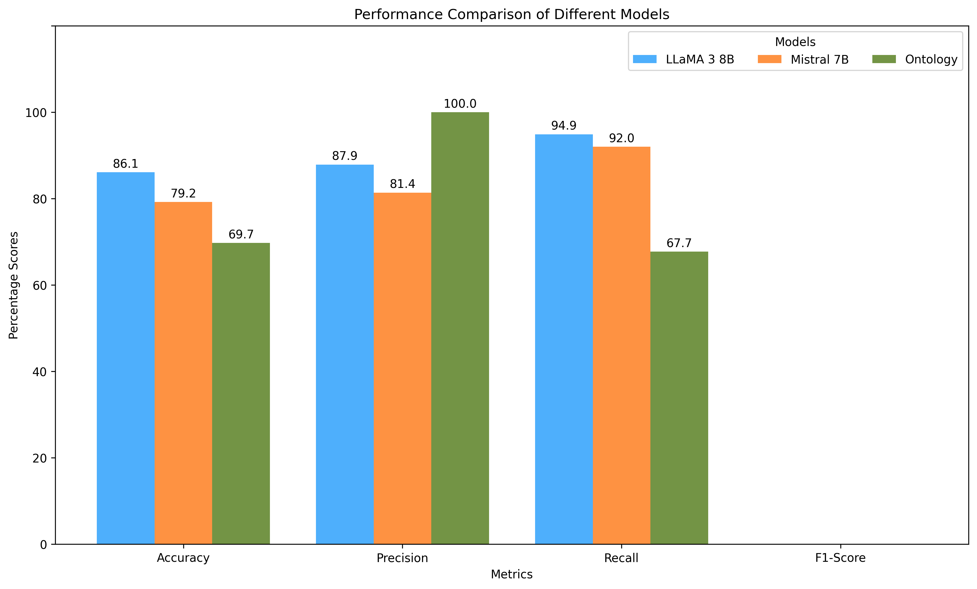
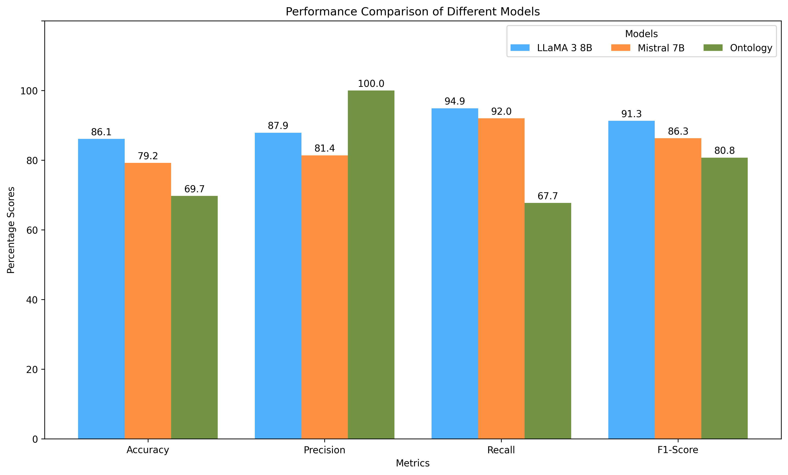
Results
*
* The Ontology system does not hallucinate – meaning it only picks information if it is present
7/4/2024

Slide 14
Limitations
Hallucinations
The LLM has tendencies to report information that is not present in the notes
Resource Intensive
LLMs require gigabytes of GPU RAM to load and operate
7/4/2024

Slide 15
Contributions
Semantic relationship retained
No external dependencies
Process notes faster than Ontology system
Ensures security and privacy of data
7/4/2024

Slide 16
Future Works
Work on more cancer types and diseases
Shift to processing on mainstream LLMs
Reduce hallucination through ReAct Prompting
Enhance Multi-Document Information Extraction
7/4/2024

